Slide 1
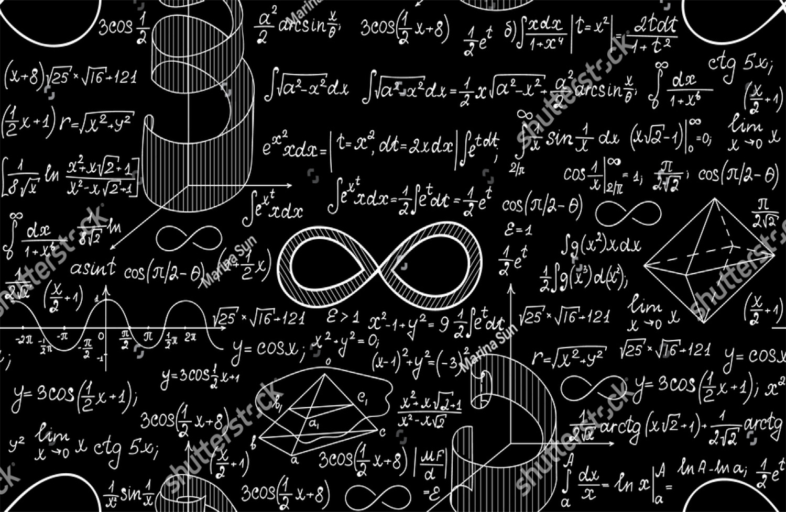
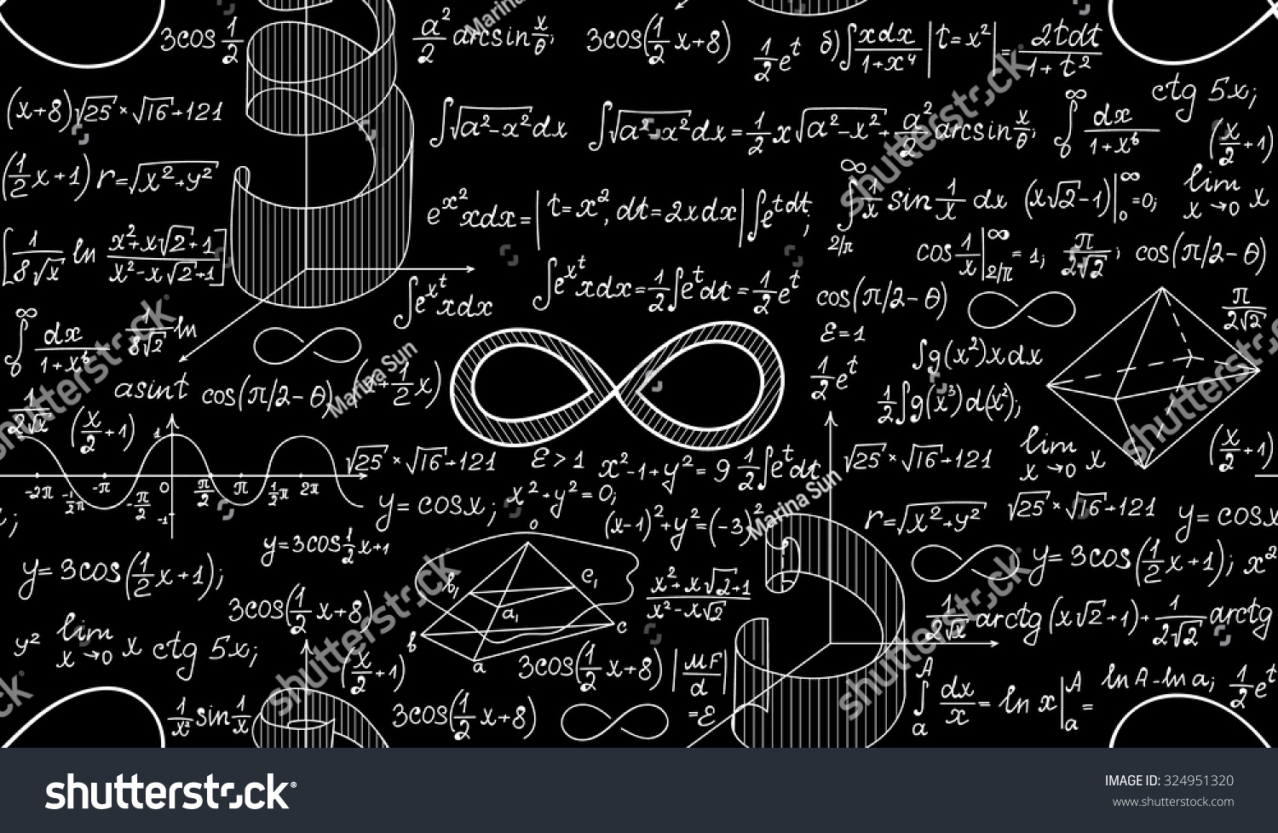

The History Of Infinity
The History Of Infinity

Slide 2


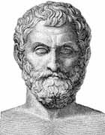


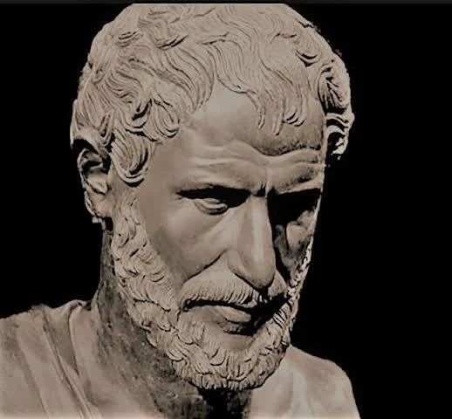
The Origin Of Infinity
Anaximander introduced the apeirion “the boundless” as an eternal, unlimited origin of all things, marking one of the earliest recorded attempts to understand infinity.
Pythagoreans saw the universe as finite and ordered. The discovery of irrational numbers, such as √2, disrupted this view because it showed structures which were non-repeating and infinite.
Zeno of Elea turned infinity into a significant philosophical problem through paradoxes that questioned infinite divisibility and the possibility of completing infinite processes.
The paradoxes of Zeno have also been called "one of the most successful provocations in the history of philosophy," and for good reason.
Aristotle made a main distinction between the potential infinite-never-ending processes-and the actual infinite-completed infinite quantities-and viewed the latter as logically unacceptable.
z

Slide 3





Infinity In Religion
Medieval thinkers of the Christian, Islamic, and Jewish traditions linked the notion of infinity with the nature of God.
St. Augustine and Thomas Aquinas, among others, elaborated that God is infinite in power and perfection, beyond the grasp of humans.
They accepted Aristotle's contention that actual infinity cannot exist in the physical world.Hence, they believed that only God's existence could be truly infinite

Slide 4

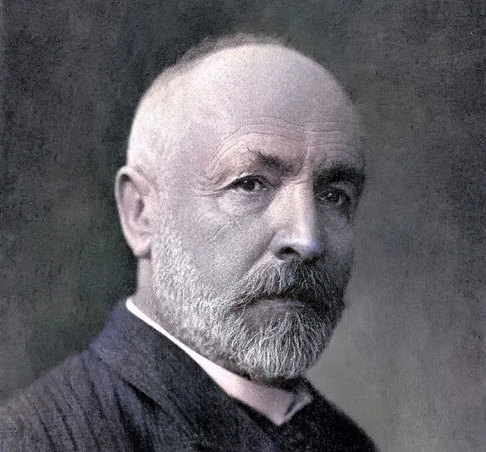
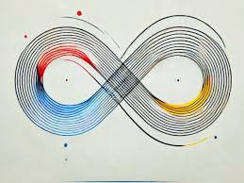

I
Infinity And Cantor
In the latter half of the 19th century, Georg Cantor changed how people thought about infinity by developing set theory and demonstrating that different sized infinities were possible.
He showed that the real numbers constitute a greater, uncountable infinity than the infinite set of natural numbers.
Cantor introduced transfinite numbers for these different magnitudes of infinity, and he developed notation for the smallest infinite quantity.
His ideas met fierce resistance initially-most notably from Leopold Kronecker-but later became integral to modern mathematics.

Slide 5

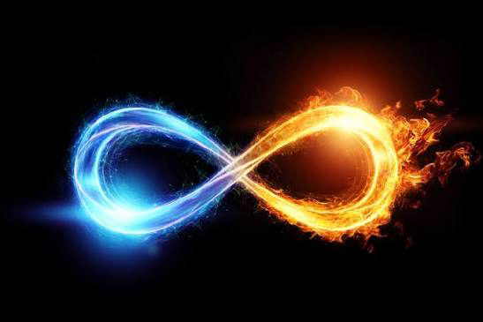

Infinity Today
Mathematics & Computing: calculus, limits, and infinite series, algorithms, data structures.
Physics and Cosmology: It appears in the modeling of universes, in discussions on singularities, e.g., black holes, and theories on the size of the universe or the multiverse.
Engineering & Technology: Infinite processes and limits guide signal processing, control theory, and the design of systems that approximate ideal or continuous behaviour.
Infinity continues to be central to debates over the nature of the universe, the foundations of mathematics, and questions about the infinite regress of causes or explanations.

